Slide 1
Getting Started with National History Day in Wisconsin

Slide 2
What is NHD in Wisconsin
It’s organized at the state and national level
It’s thematic project-based learning using primary and secondary sources
It empowers students
It can be competitive…or not
Let’s break it down
Notes:
Gif via giphy.com credit National Basketball Player’s Association

Slide 3
Every state and some US territories have an NHD program
In Wisconsin, the state is broken into different regions
Eau Claire
Green Bay
La Crosse
Milwaukee
Milwaukee North
Minocqua
Stevens Point
And each region has a coordinator who can be someone local or back in Madison
Notes:
Giphy.com spinning earth

Slide 4
It’s Thematic!
NHD helps guide students with a new theme every year
These themes are meant to help students select and narrow down their choice of topics

Slide 5
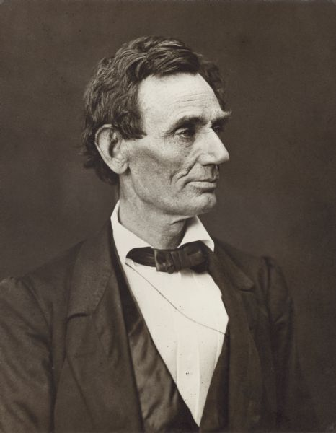
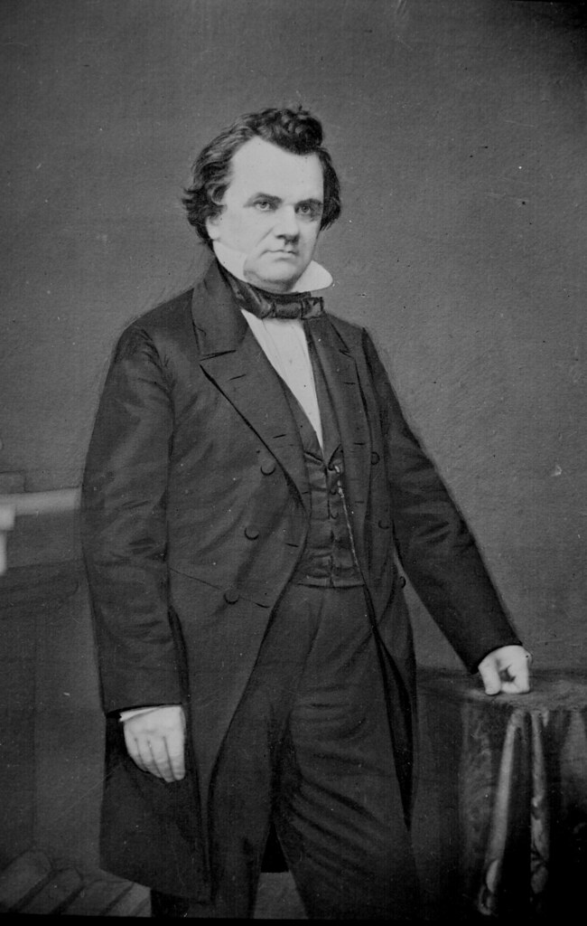
It’s Project-Based Learning That Aligns with Wisconsin State Standards
The framework of NHD centers on student choice; choosing any topic they want that you, the educator, find appropriate
Want to study the origins of punk rock? Go forth, young Strummer! Carry on, young Jett!
The Lincoln-Douglas debates? No argument here.
Notes:
Lincoln: Image ID:23664; Stephen Douglas "Stephen A Douglas, Senator from Illinois" by Marion Doss is licensed under CC BY-SA 2.0; "Punk Rock Fest 3" by ilovememphis is licensed under CC BY-ND 2.0;

Slide 6
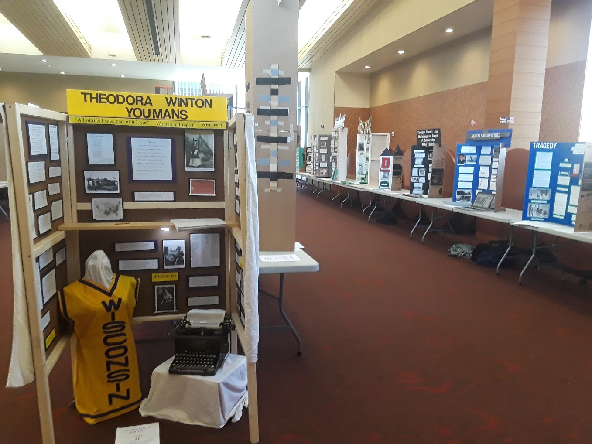
It’s Empowering!
Students choose how they want to tell their story, choosing from five different methods…
The Exhibit
Curate your images and quotes to display your knowledge
Notes:
Various exhibits, 2018 State competion

Slide 7
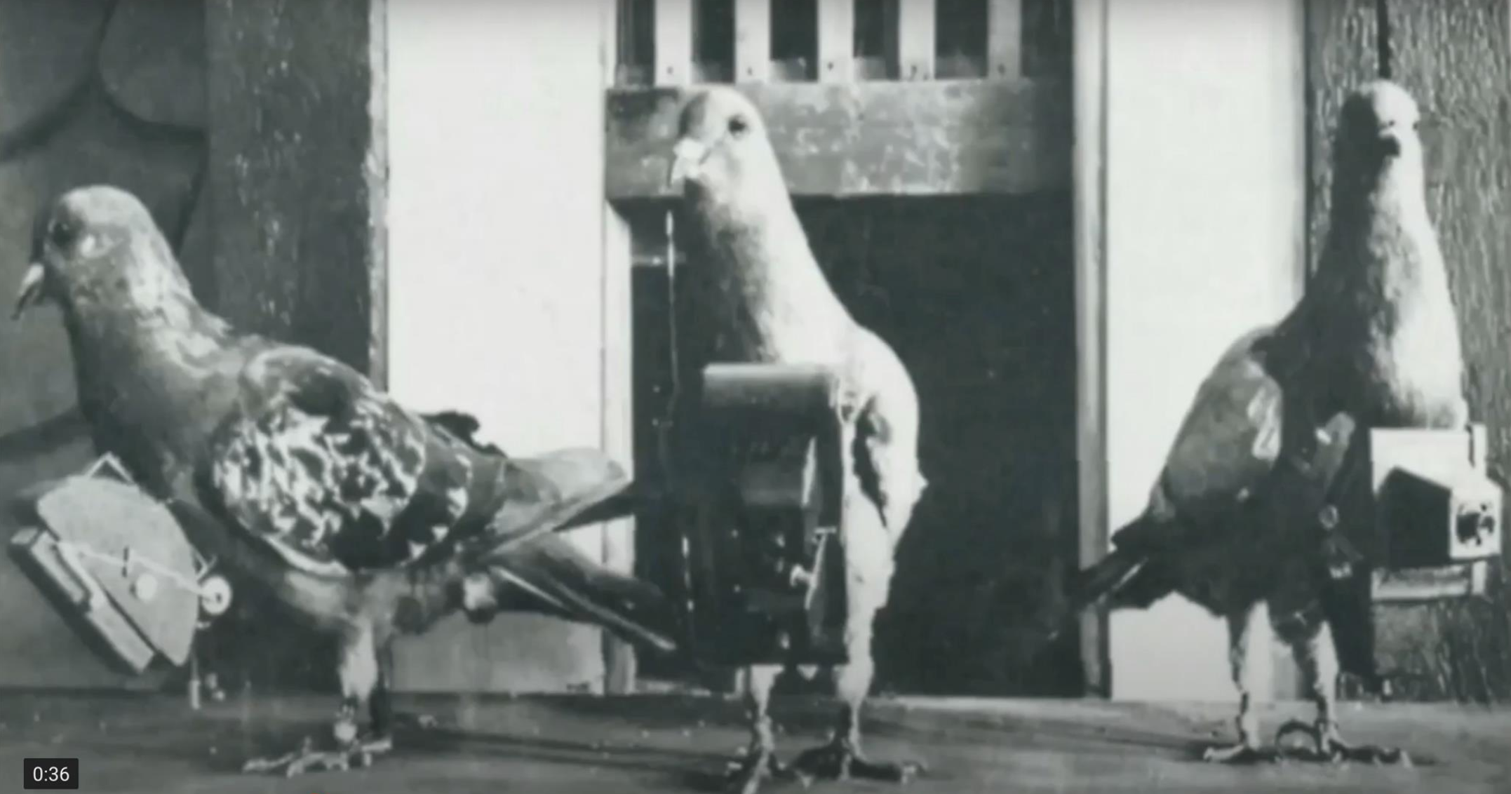
It’s Empowering!
Students choose how they want to tell their story, choosing from five different methods…
The Documentary
Who will be the next Ken Burns? It could be you!
Notes:
The Nine Ounce Winged Warriors Homing Pigeons by Shruti C, Senior Division State Finalist

Slide 8
It’s Empowering!
Students choose how they want to tell their story, choosing from five different methods…
The Website
Develop your own pick-a-path to information creation!
Notes:
Breaking Enigma and Reinventing Communication for the Future by Zoha A, Junior Division State finalist

Slide 9
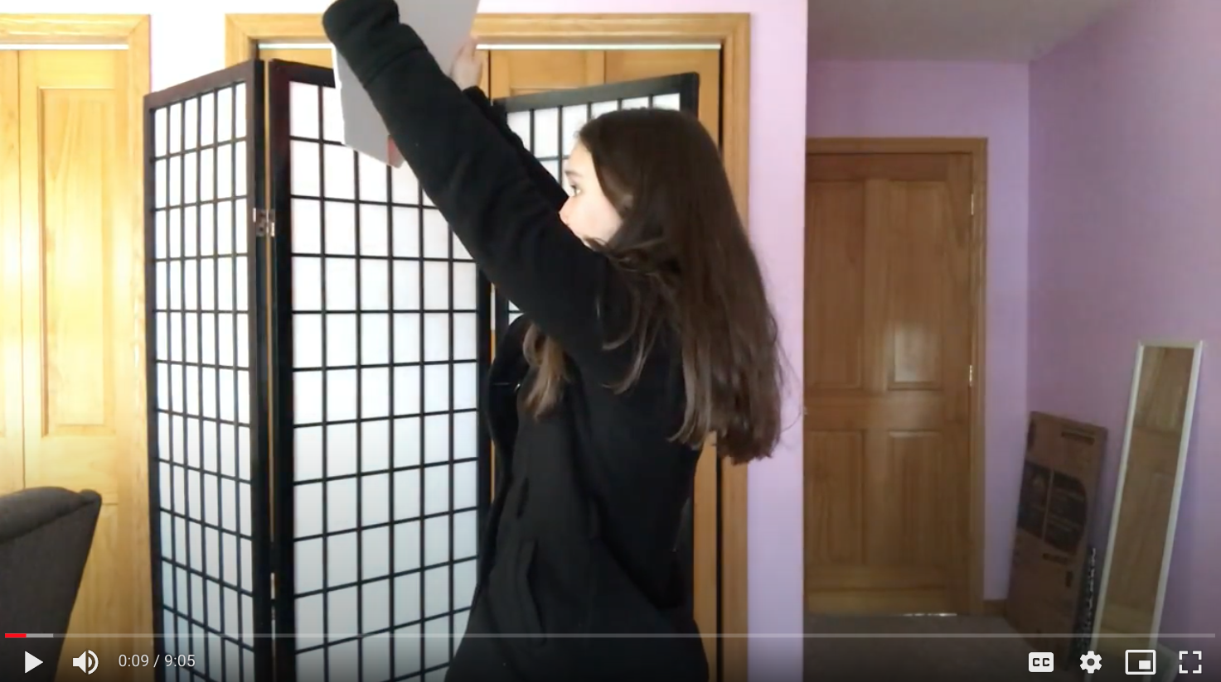
It’s Empowering!
Students choose how they want to tell their story, choosing from five different methods…
The Performance
To be or not to be a thespian-that is the question!
Notes:
The First Amendment and Tinker : Student Speech and Communication, Sandy B, Senior Division State finalist

Slide 10
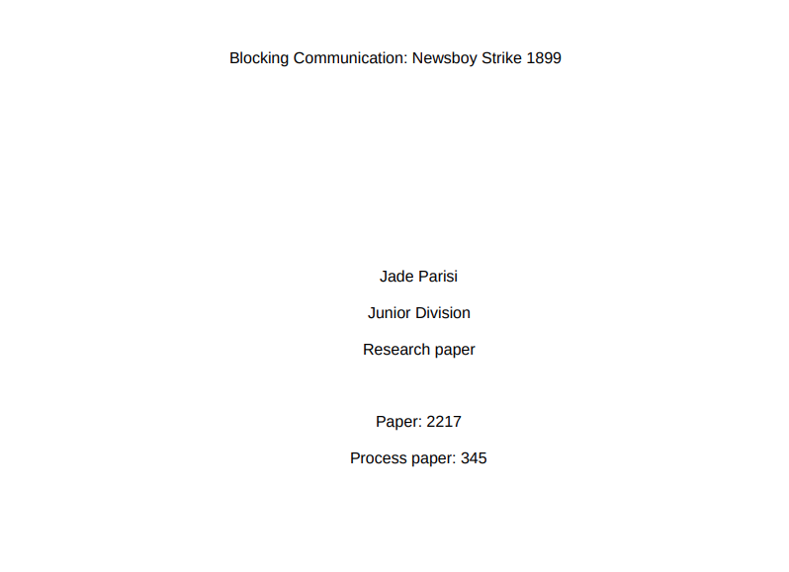
It’s Empowering!
Students choose how they want to tell their story, choosing from five different methods…
The Paper
Flex those writing skills!
Notes:
Blocking Communication: Newsboy Strike 1899, Jade P, Junior Division State Finalist

Slide 11
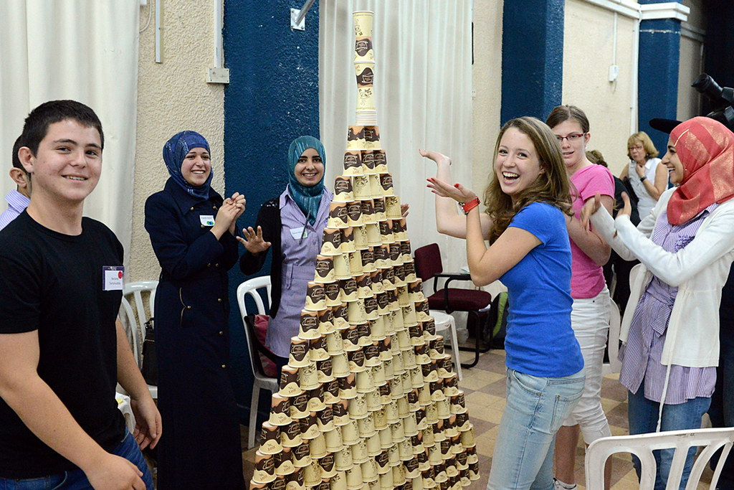
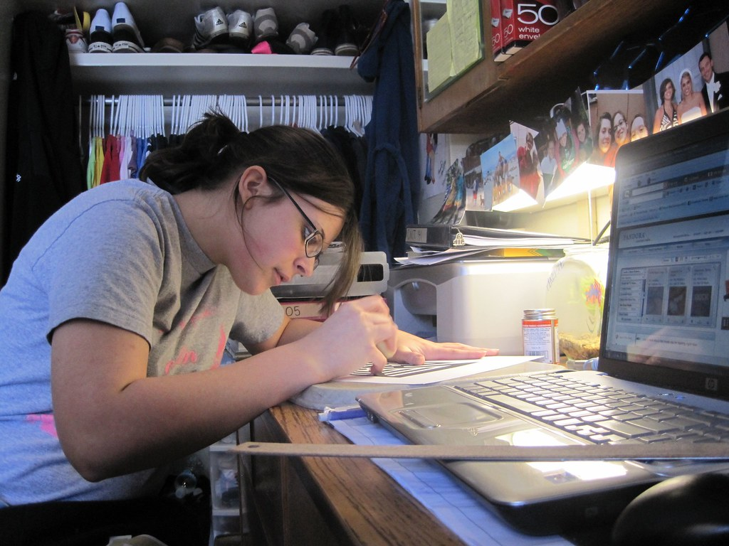
It’s Empowering!
And, your students can choose whether they want to work on their projects solo (called Individual) or with partners (called Group)
Notes:
"studying" by English106 is licensed under CC BY 2.0; "PON2012_No.019RL" by U.S. Embassy Jerusalem is licensed under CC BY-SA 2.0

Slide 12
To Compete…or Not
Students choose how they want to tell their story, choosing from five different methods…
You can choose to have your class compete in the NHD contest season…
You can host a school event (optional even if you don’t want to go any further!)
You can go to regionals with your scholars
You can go to the state competition in Madison
You might even send some kids to the national contest in Maryland!
Or…not. You don’t have to compete at all to be part of the program
Learn More about the competition?
Skip it! We’re here for the history!
Notes:
Ball State University giphy.com
@BallState

Slide 13
The Competition Cycle…with Prizes!
Students choose how they want to tell their story, choosing from five different methods…
You can think of the NHD competition cycle like a funnel that starts spinning around September
Everyone starts out at the top…understanding the theme, choosing topics, working on their projects and getting them ready to compete
Sometime in January, some teachers choose to hold class or school events to determine who to send to the next level…
Which is the regional level, where your young scholars will put their projects to the test of our NHD judges…this kicks off in February and goes through March.
The winners from the regional level move on to the state competition in Madison (the funnel is getting smaller!) – It’s now April!
Winners from the state contest get to compete at the national level, and that’s a wrap (in June)!
Notes:
Matthew Butler giphy.com
@butler

Slide 14
The Competition Cycle…Continued!
Tiers…not tires, which are also important…
There are tiers! Juniors (grades 6-8) compete against Juniors, and Seniors (Grades 9-12) compete against Seniors
And that’s the Competition Cycle!
Notes:
Foil Arms and Hog giphy.com
@foilarmsandhog

Slide 15
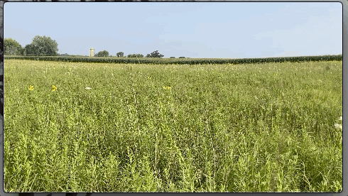
The Non-Competition Cycle
There are no contest rules!
You decide when to start working on your projects and…
You decide when you are done!
You get the same level of support we give our competitors!
Notes:
Prairie Media: Kurt Griesemer

Slide 16
Can I Grade the Work?
The short answer is…yes!
NHD aligns well with the Wisconsin State Standards
Many teachers use the work as part of a students’ social studies grade
The work is rigorous! Students compile massive amounts of research as they comb through archives, visit museums, study in libraries, conduct interviews and more.
No scholarly work is complete without citations and original ideas, and that’s what makes for a great NHD project.
So no wasted class time-just time-tested project based learning! We even provide the rubric!

Slide 17
But Wait, There’s More!
Of course there’s much more to NHD than what we’ve laid out here
It takes dedication from you and your students
It can take time to understand the process for you and your students
There are rules about word limits, bibliographies, citations, quotes, sizes…
Competitions can be tough on young scholars, but also fun!
It’s a great public history showcase!
Doing good history is hard!
Notes:
Foil Arms and Hog giphy.com
@foilarmsandhog

Slide 18
So…Now What?
Ready to jump in? Great!
Surf on over to wisconsinhistory.org/nhd
Look for the Teacher Guide Book! It’s filled with great information to get you started.
Contact us! We’re always willing to help! historyday@wisconsinhistory.org
Categories
Tiers
Rules
Registration
Calendar Dates
Whatever you need to get going!
We’re looking forward to seeing YOU at National History Day in Wisconsin!
Notes:
Better Make Room
@bettermakeroom giphy.com Michelle Obama

Slide 19
*Jeff Goldblum not included
Notes:
Film4 giphy.com
@film4

